Slide 1
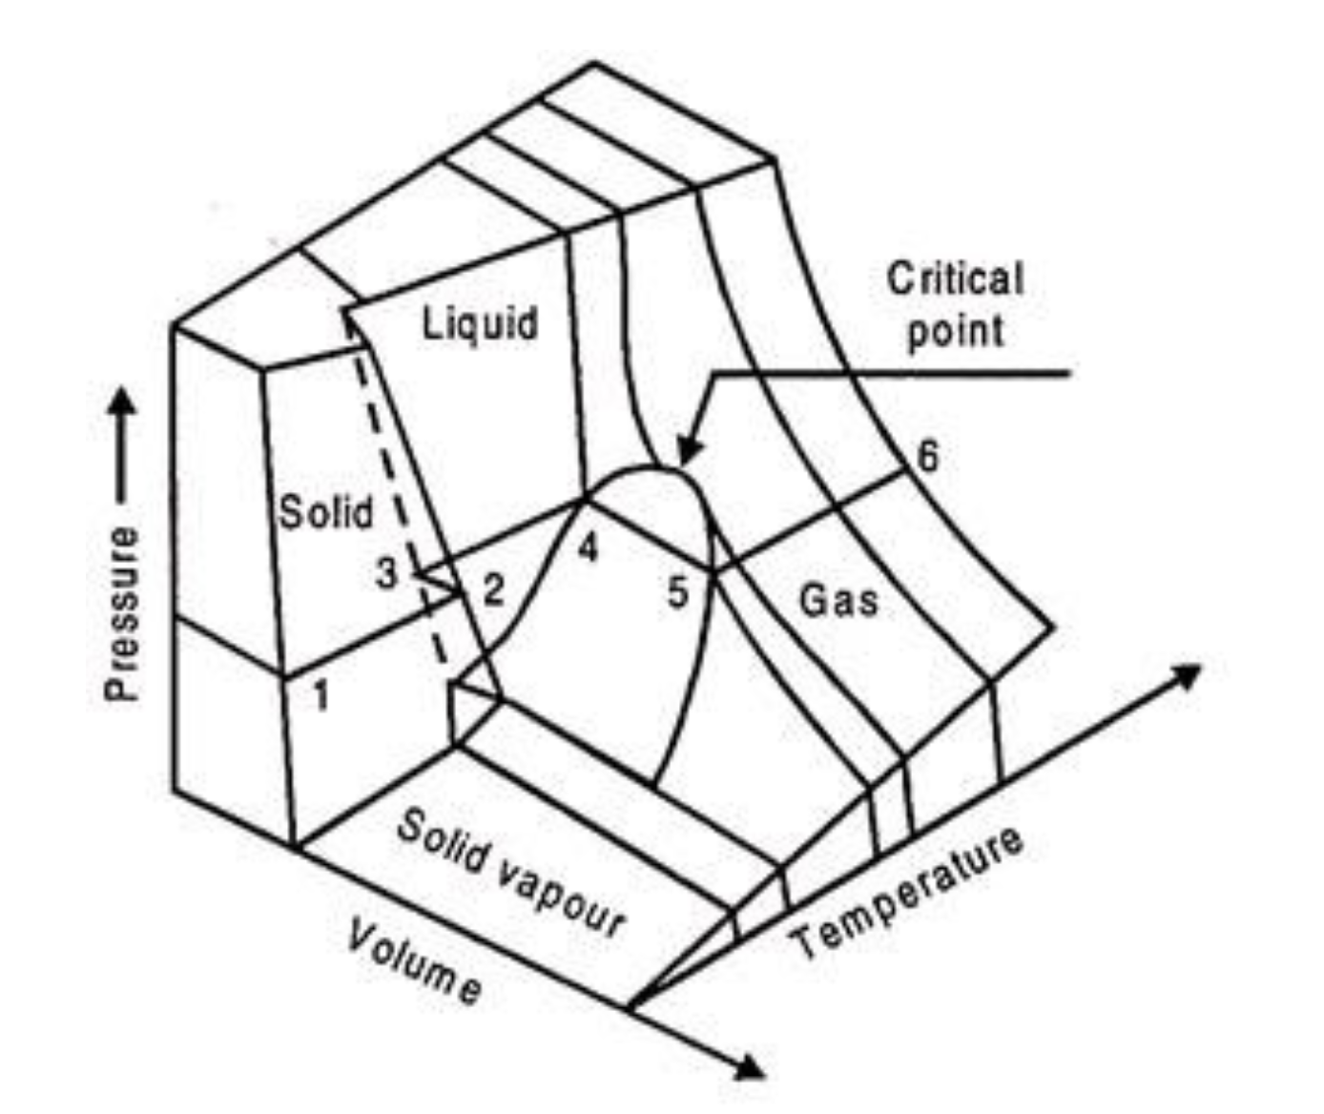
What all gases/liquids/solids do
The Principle of Corresponding States says all substances do this, just at different temperatures and volumes
https://www.engineeringenotes.com/thermal-engineering/real-gases/real-gases-properties-van-der-waals-equation-and-equation-of-state-thermal-engineering/49112

Slide 2
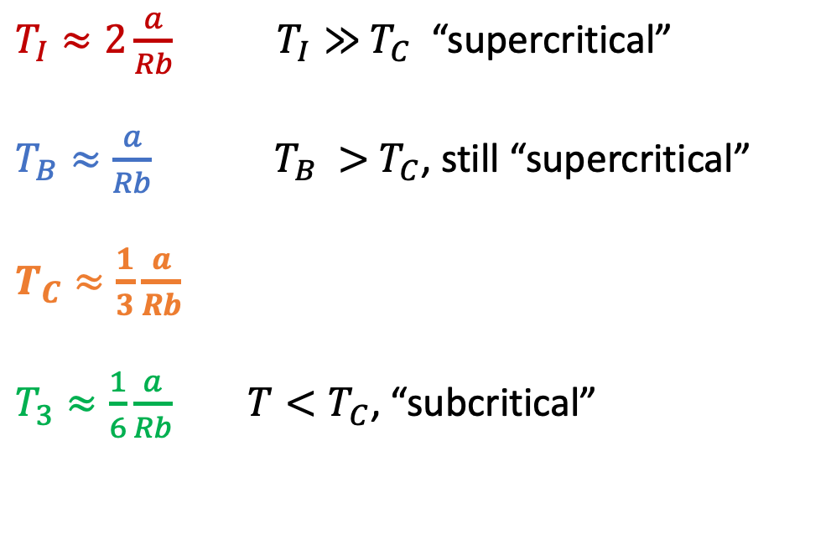
Relationships between these temperatures
$T_{I}≈2\frac{a}{Rb}$ $T_{I}≫{ T}_{C}$ “supercritical”
$T_{B}≈\frac{a}{Rb}$ $T_{B} >{ T}_{C}$, still “supercritical”
$T_{C}≈\frac{1}{3}\frac{a}{Rb}$
$T_{3}≈\frac{1}{6}\frac{a}{Rb}$ $T<T_{C}$, “subcritical”
https://www.engineeringenotes.com/thermal-engineering/real-gases/real-gases-properties-van-der-waals-equation-and-equation-of-state-thermal-engineering/49112

Slide 3


How you can tell if a gas is supercritical or subcritical
Isothermal compression below and above the critical temperature
$$T<T_{c}$$
$$T>T_{c}$$
gas
gas
Super-critical Gas/
Liquid
gas
liquid
liquid
liquid

Slide 4
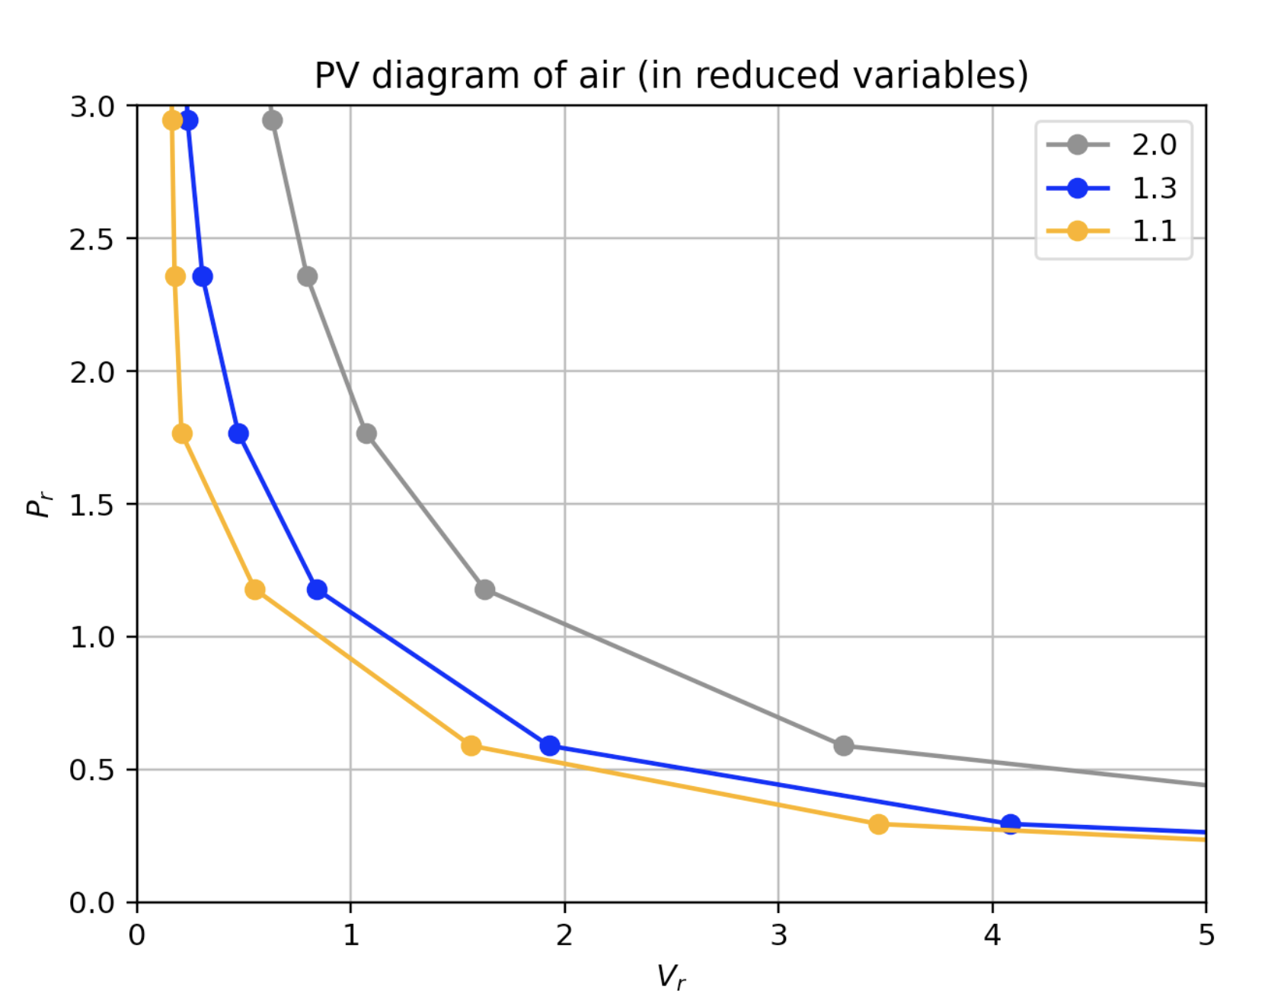
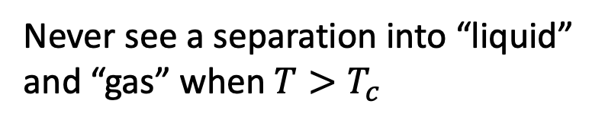
How you can tell if a gas is supercritical or subcritical
$$T>T_{c}$$
Never see a separation into “liquid” and “gas” when $T>T_{c}$
gas
Super-critical Gas/
Liquid
liquid

Slide 5

How you can tell if a gas is supercritical or subcritical
$$T>T_{c}$$
Never see a separation into “liquid” and “gas” when $T>T_{c}$
gas
Super-critical Gas/
Liquid
liquid

Slide 6
Approaching 𝑻_{𝒄rit} from above
$$T>T_{c}$$
But there’s a hint of something afoot: along colder isotherms, P(V) gets flatter and flatter.
gas
Super-critical Gas/
Liquid
liquid

Slide 7
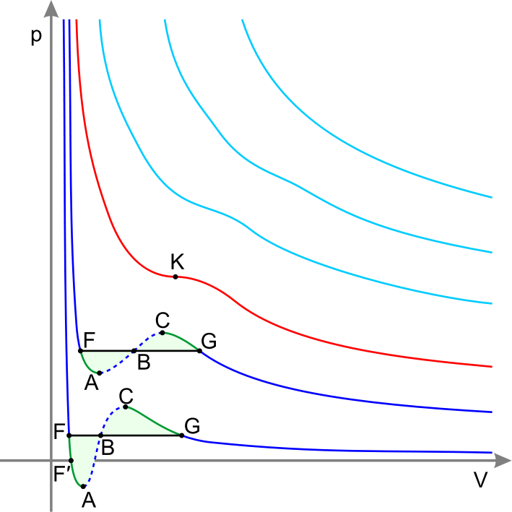


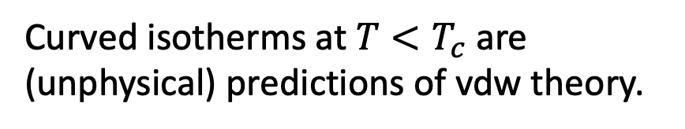
van der Waals formula actually does a good job when 𝑻>𝑻_{𝒄rit}
Isothermal compression in a PV diagram
$$T>T_{c}$$
$$T=T_{c}$$
T_{crit}
Curved isotherms at $T<T_{c}$ are (unphysical) predictions of vdw theory.

Slide 8
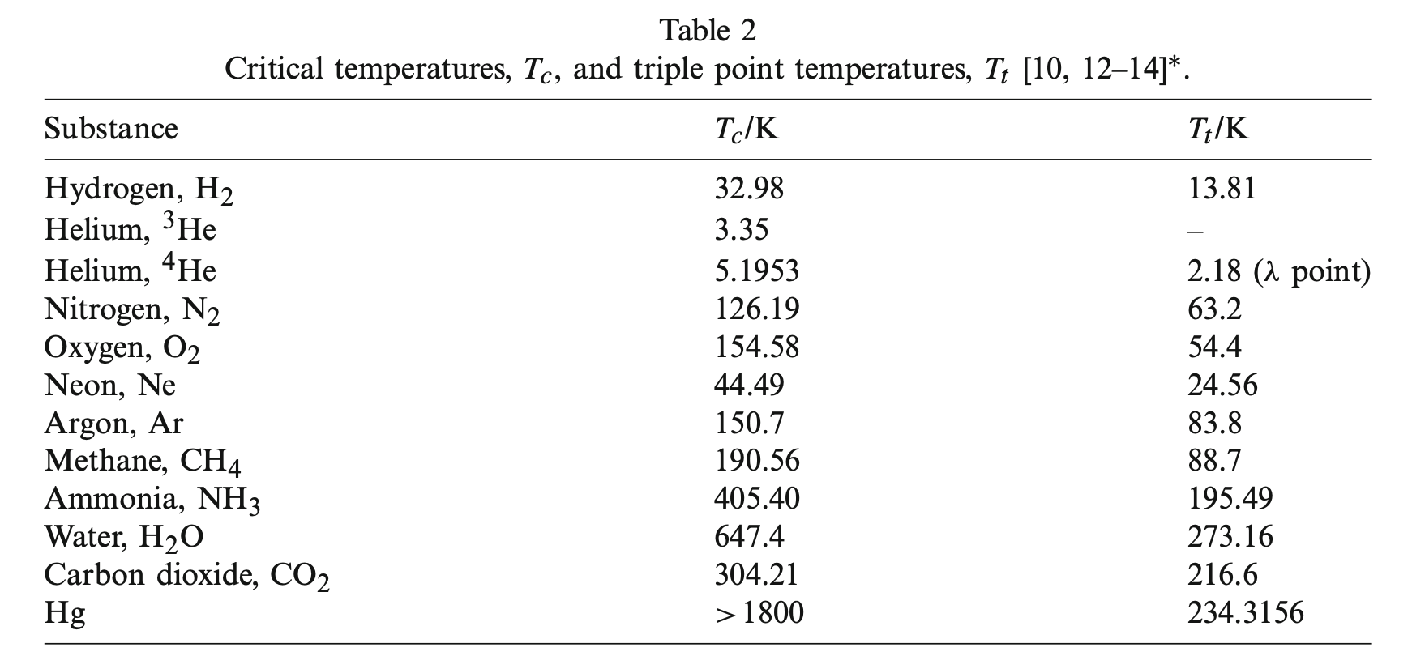

Every gas has its own critical temperature
$$T_{3}/K$$
From Berberberan-Santos et al, 2008

Slide 9

Every gas has its own critical temperature
$$T_{3}/K$$
From Berberberan-Santos et al, 2008
H₂ molecules are not very sticky, so it’s hard to liquify H₂ gas
=> H₂ has a really low critical temperature.

Slide 10
Every gas has its own critical temperature
$$T_{3}/K$$
From Berberberan-Santos et al, 2008
H₂O and NH₃ molecules are very sticky (they have hydrogen bonding!) so it’s easy to liquify them.
=> H₂O and NH₃ have a really high critical temperature.

Slide 11
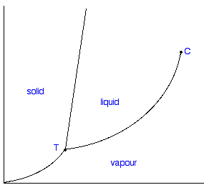

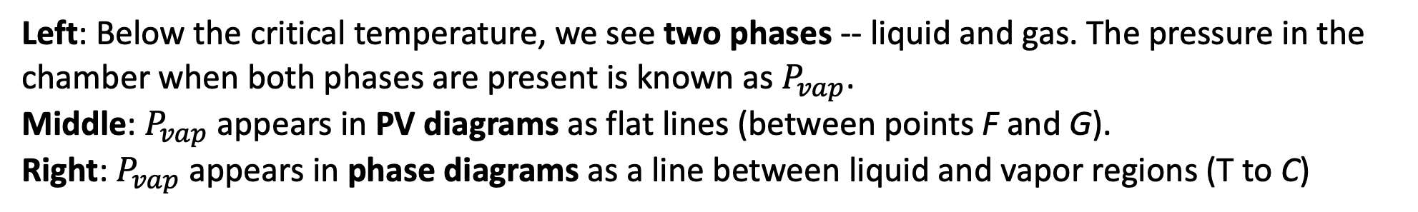


When the temperature is sub-critical ($T<T_{c}$), two phases (gas and liquid) are in equilibrium
Left: Below the critical temperature, we see two phases -- liquid and gas. The pressure in the chamber when both phases are present is known as $P_{vap}$.
Middle: $P_{vap}$ appears in PV diagrams as flat lines (between points F and G).
Right: $P_{vap}$ appears in phase diagrams as a line between liquid and vapor regions (T to C)
$$T<T_{c}$$
PV diagram
Phase diagram
$$P$$
gas
gas
liquid
$$T$$

Slide 12
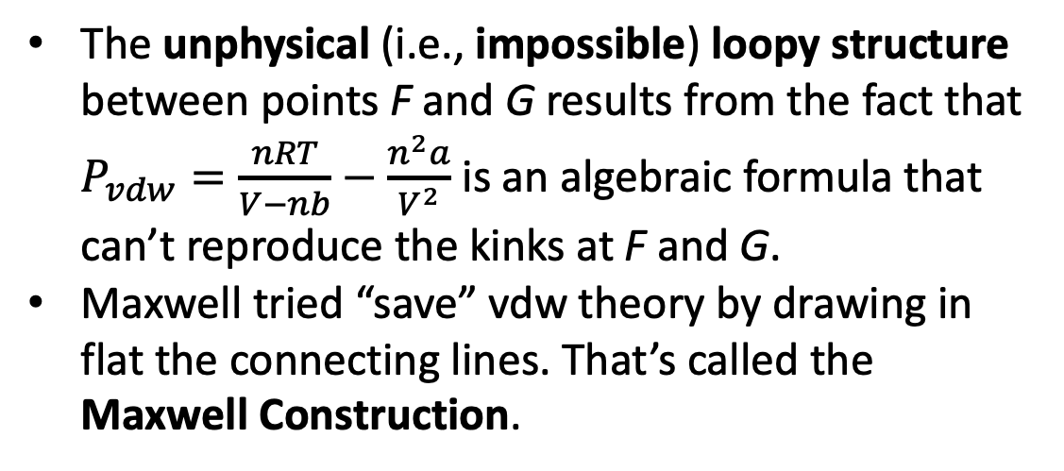
How Maxwell tried to save vdw theory in the 2-phase region
The unphysical (i.e., impossible) loopy structure between points F and G results from the fact that $P_{vdw}=\frac{nRT}{V−nb}−\frac{n^{2}a}{V^{2}}$ is an algebraic formula that can’t reproduce the kinks at F and G.
Maxwell tried “save” vdw theory by drawing in flat the connecting lines. That’s called the Maxwell Construction.

Slide 13
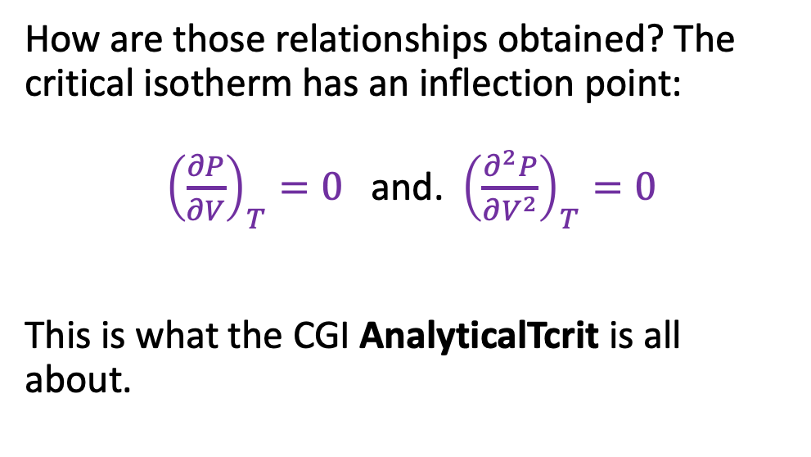
Relating vdw’s a and b to $T_{C}$ and $V_{C}$
How are those relationships obtained? The critical isotherm has an inflection point:
${\left(\frac{∂P}{∂V}\right)}_{T}=0$ and. ${\left(\frac{∂^{2}P}{∂V^{2}}\right)}_{T}=0$
This is what the CGI AnalyticalTcrit is all about.

Slide 14
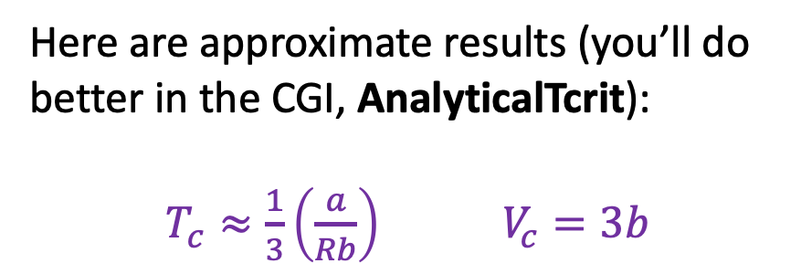
Analytical properties of vdw’s equation
Here are approximate results (you’ll do better in the CGI, AnalyticalTcrit):
$T_{c}≈\frac{1}{3}\left(\frac{a}{Rb}\right)$ $V_{c}=3b$
The ratio is not actually 1/3, it’s 8/27.

Slide 15
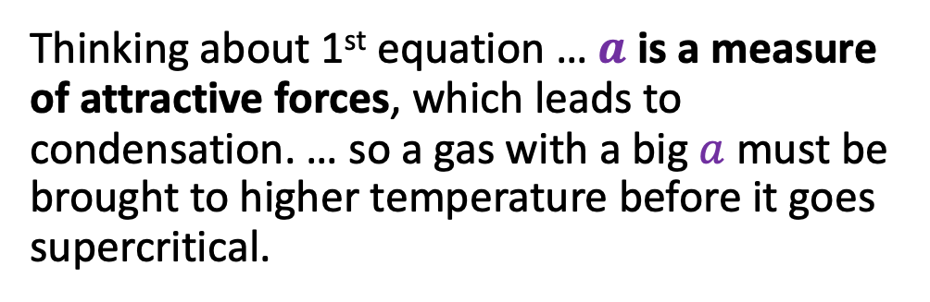
Analytical properties of vdw’s equation
Here are approximate results (you’ll do better in the CGI, AnalyticalTcrit):
$T_{c}≈\frac{1}{3}\left(\frac{a}{Rb}\right)$ $V_{c}=3b$
Thinking about 1st equation … $a$ is a measure of attractive forces, which leads to condensation. … so a gas with a big $a$ must be brought to higher temperature before it goes supercritical.

Slide 16
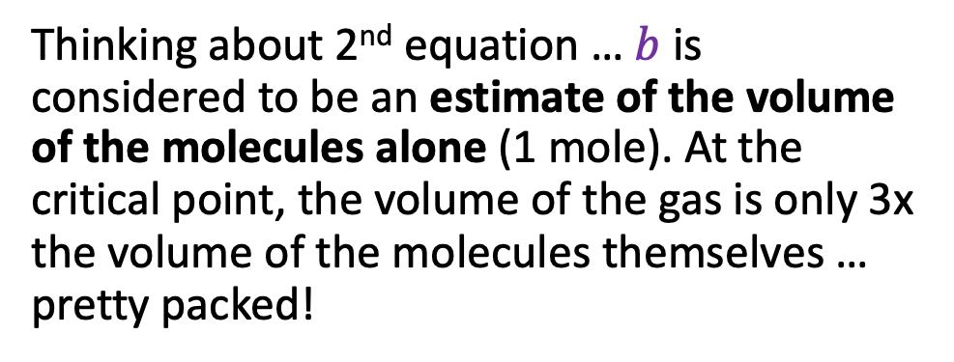
Analytical properties of vdw’s equation
Here are approximate results (you’ll do better in the CGI, AnalyticalTcrit):
$T_{c}≈\frac{1}{3}\left(\frac{a}{Rb}\right)$ $V_{c}=3b$
Thinking about 2nd equation … $b$is considered to be an estimate of the volume of the molecules alone (1 mole). At the critical point, the volume of the gas is only 3x the volume of the molecules themselves … pretty packed!

Slide 17
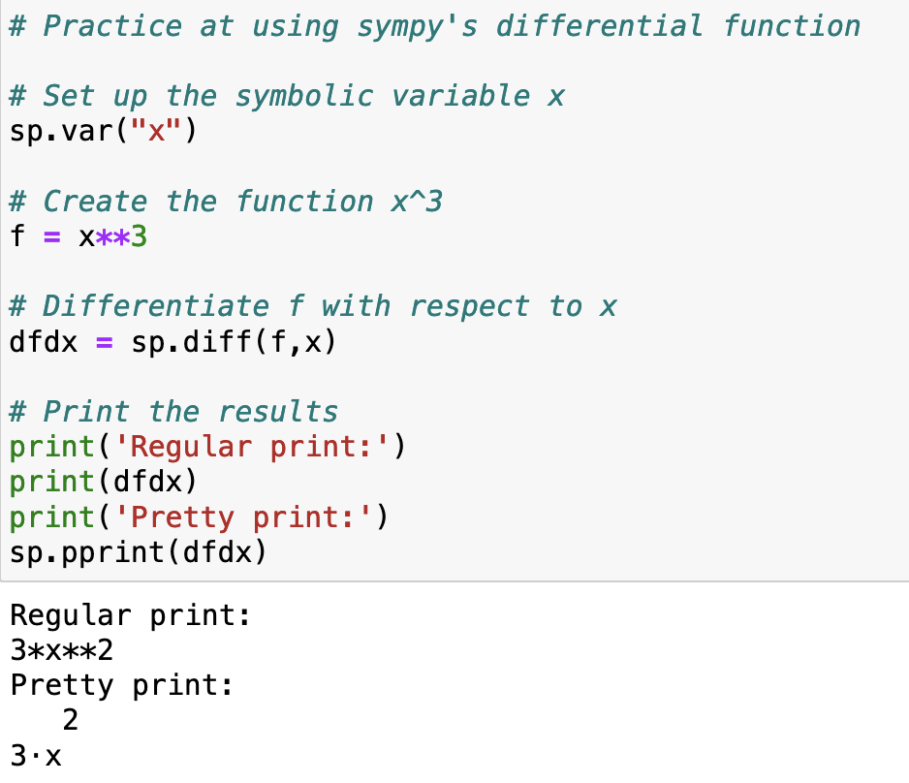
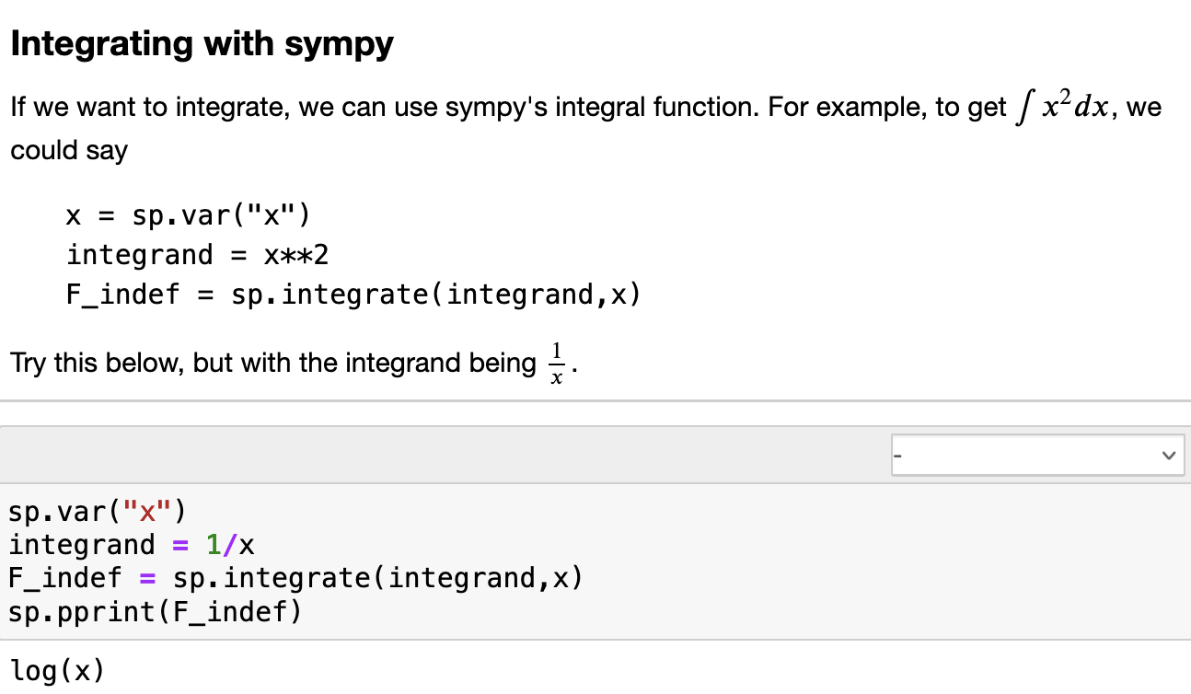
Solving for critical points requires calculus … which sympy can do

Slide 18
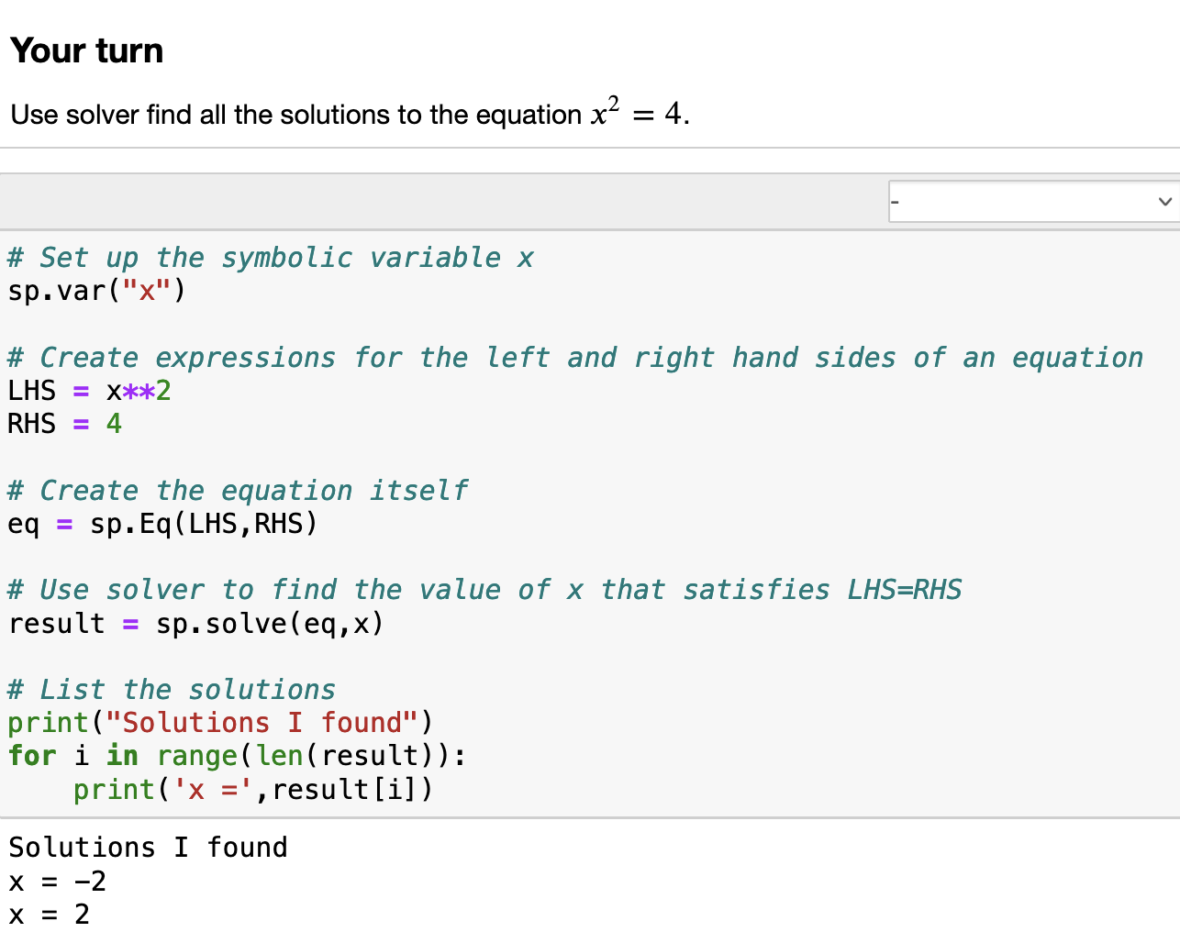
Solving for critical points also requires solving equations … which sympy can do

Slide 19
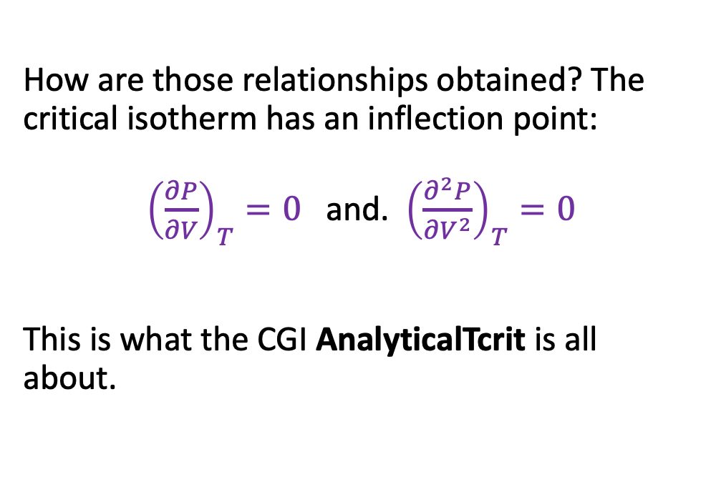
It actually requires solving two simultaneous equations … which sympy can do too
How are those relationships obtained? The critical isotherm has an inflection point:
${\left(\frac{∂P}{∂V}\right)}_{T}=0$ and. ${\left(\frac{∂^{2}P}{∂V^{2}}\right)}_{T}=0$
This is what the CGI AnalyticalTcrit is all about.

Slide 20
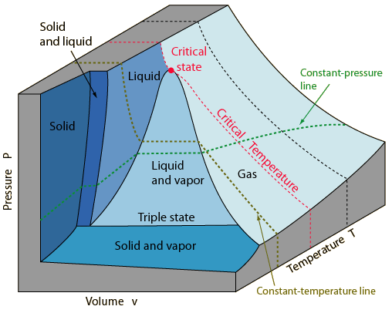
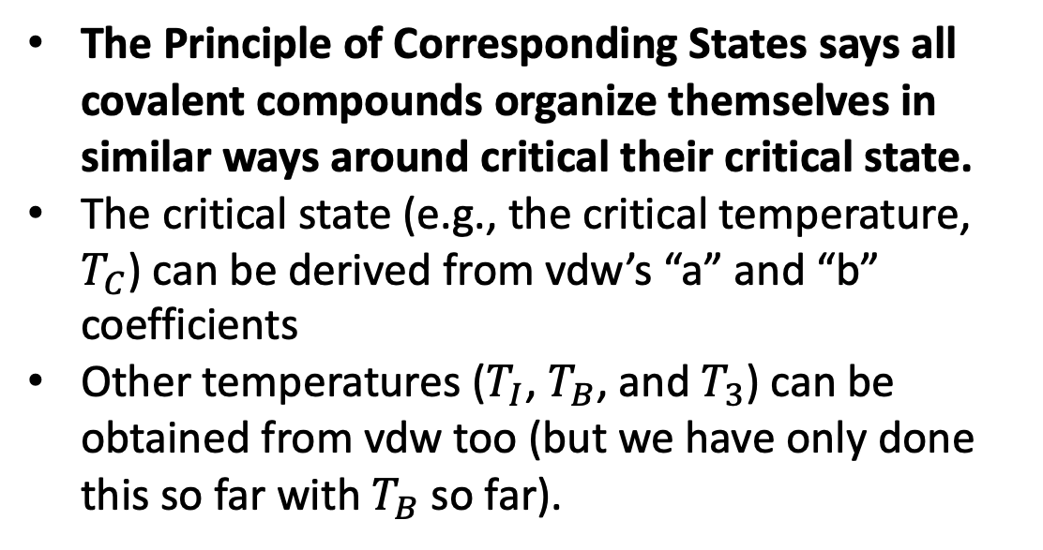
Take-home points
The Principle of Corresponding States says all covalent compounds organize themselves in similar ways around critical their critical state.
The critical state (e.g., the critical temperature, $T_{C}$) can be derived from vdw’s “a” and “b” coefficients
Other temperatures ($T_{I}$, $T_{B}$, and $T_{3}$) can be obtained from vdw too (but we have only done this so far with $T_{B}$ so far).

Slide 21
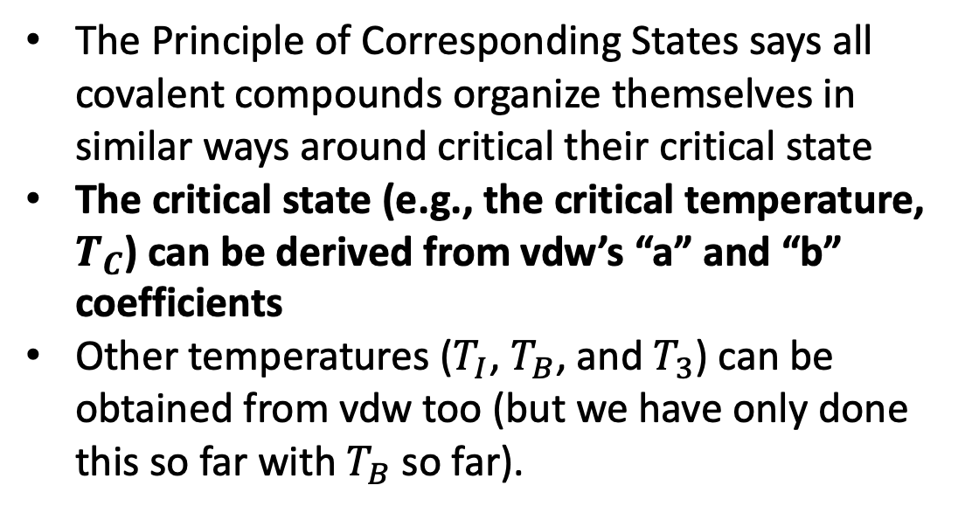

Take-home points
The Principle of Corresponding States says all covalent compounds organize themselves in similar ways around critical their critical state
The critical state (e.g., the critical temperature, $T_{C}$) can be derived from vdw’s “a” and “b” coefficients
Other temperatures ($T_{I}$, $T_{B}$, and $T_{3}$) can be obtained from vdw too (but we have only done this so far with $T_{B}$ so far).
${\left(\frac{∂P}{∂V}\right)}_{T}=0$ and ${\left(\frac{∂^{2}P}{∂V^{2}}\right)}_{T}=0$

Slide 22
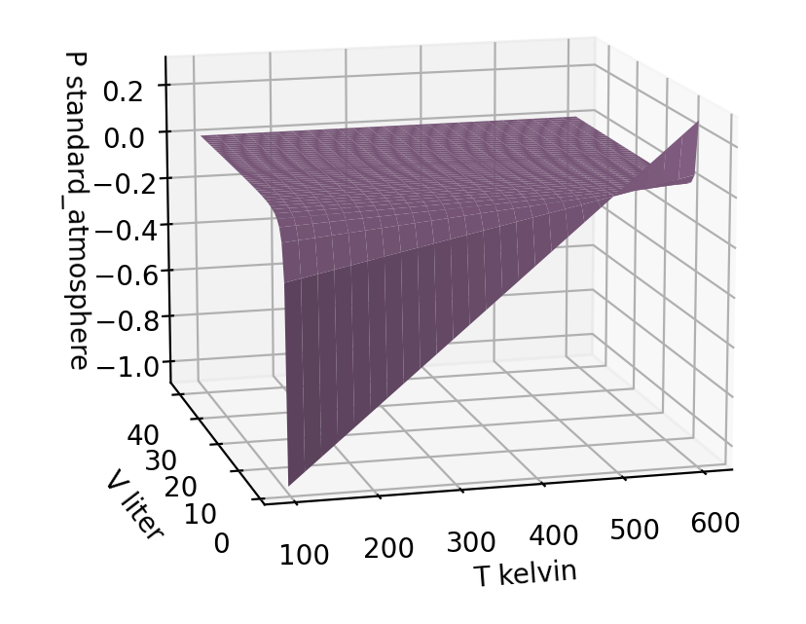
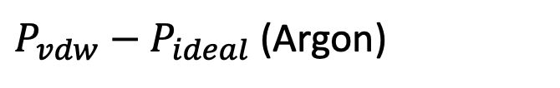
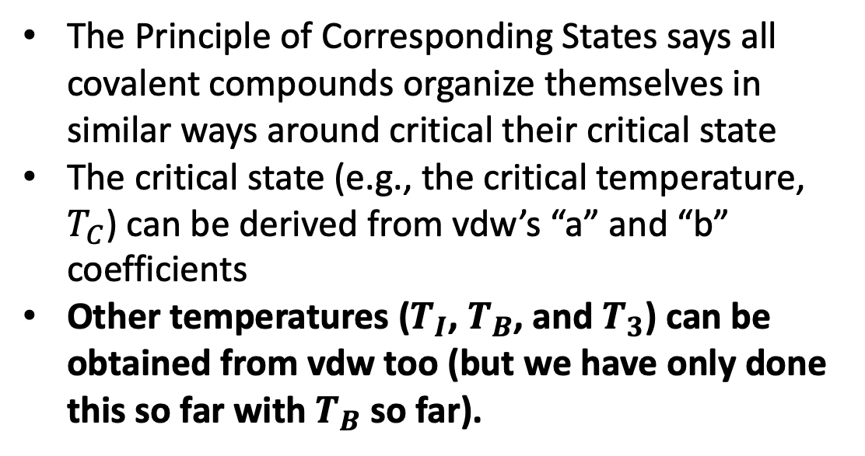
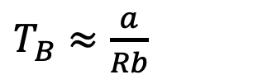
Take-home points
The Principle of Corresponding States says all covalent compounds organize themselves in similar ways around critical their critical state
The critical state (e.g., the critical temperature, $T_{C}$) can be derived from vdw’s “a” and “b” coefficients
Other temperatures ($T_{I}$, $T_{B}$, and $T_{3}$) can be obtained from vdw too (but we have only done this so far with $T_{B}$ so far).
$P_{vdw}−P_{ideal}$ (Argon)
$T_{B}≈\frac{a}{Rb}$

Slide 23
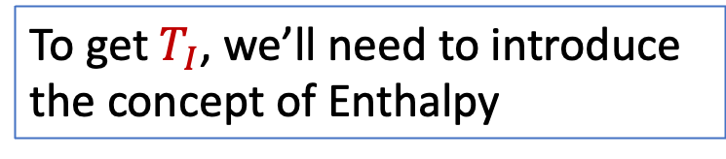
Relationships between these temperatures
$T_{I}≈2\frac{a}{Rb}$ $T_{I}≫{ T}_{C}$ “supercritical”
$T_{B}≈\frac{a}{Rb}$ $T_{B} >{ T}_{C}$, still “supercritical”
$T_{C}≈\frac{1}{3}\frac{a}{Rb}$
$T_{3}≈\frac{1}{6}\frac{a}{Rb}$ $T<T_{C}$, “subcritical”
To get $T_{I}$, we’ll need to introduce the concept of Enthalpy
https://www.engineeringenotes.com/thermal-engineering/real-gases/real-gases-properties-van-der-waals-equation-and-equation-of-state-thermal-engineering/49112

